Slide 1
Intro to Microcontroller Programming using Atmega32 Prepared By: A.K.M. Mehedi Hasan
Special Thanks to: Tareq Mahmood

Slide 2
Needed Softwares
AVR Studio
https://atmel-studio.software.informer.com/7.0/
Atmel Studio 7.0 (build 1931) offline installer
This is the IDE

Slide 3
Needed Softwares
If you get the following error:
“Atmel.VsIde.AvrStudio.Utils.MemoryPressureReliever exception” follow the steps below:
1. Go to folder where you have installed Atmel. Usually the location would be: “C:\Program Files (x86)\Atmel\Studio\7.0\Extensions\Application”
2. Replace the “Utilities.dll” file with the updated “Utilities.dll” file provided in Moodle.

Slide 4
Burner
Extreme Burner
http://extreme-burner-avr.software.informer.com/download/
There is also avrpal
This Loads the HEX file into microcontroller

Slide 5
Burner
If you get “Usbasp Programmer not found”
You need to download a driver installer software named “Zadig”.
Watch the following video for your reference:
https://www.youtube.com/watch?v=5kK2zEon3zg

Slide 6
Needed Equipments
Microcontroller – ATmega32
The AVR Programmer / Loader
To load your code into the mc

Slide 7
Writing Code
Create New Project
Select “GCC C Executable Project”
Select path to save the project
You will later need this path for the hex file
Then select device type
Search for ATmega 32
Now you can write the program

Slide 8
Compile the hex code
Finish the program
Select “Build Solution (F7)” from the Build Menu
You will find that a hex file is generated in the Debug folder
The name of the hex file will be the same as your project name

Slide 9
Load the hex into mc
Run Extreme Burner
Load the hex file into it by “Open” and locate your hex file
From menu select Chip -> ATmega32
Set the microcontroller on the AVR Programmer
Connect the programmer with PC
Optional: Click on Chip Erase to Erase the Atmega
In extreme Burner select the menu “write” and choose “Flash”

Slide 10
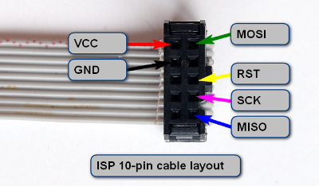
Connecting ATmega32 with programmer
Following the figure connect the 6 corresponding microcontroller pins with the loader.
Be careful about the orientation of the cable layout. The extended part goes to the right

Slide 11
Complete Process of Programming a Microcontroller
Write the code
In ATMEL Studio, or other IDE
Compile it to a .hex file.
For ATMEL Studio, you will find the hex on the “Debug” folder in your project

Slide 12
Complete Process of Programming a Microcontroller
3. Inserting the .hex file into the microcontroller
Load the hex file into burner
set the microcontroller on the “AVR Programmer”
Optional: Erase then Flash
4. Set the microcontroller in the working circuit

Slide 13
Ports for I/O
4 different ports for I/O
A, B, C, D
8 bit <-> 8 data pins
Every pin is bidirectional, can be used as input or output

Slide 14
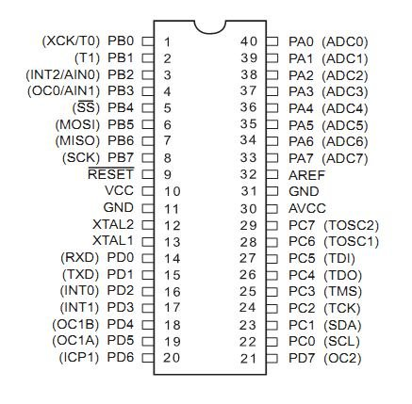
I/O Ports of ATmega32 (AVR)

Slide 15
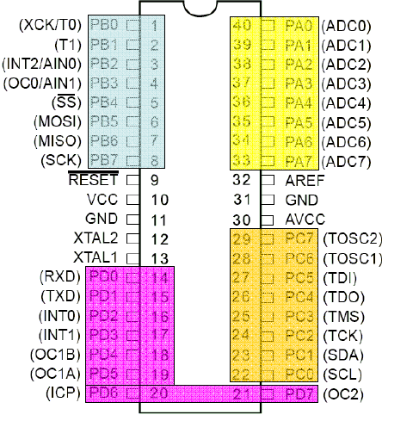
I/O Ports of ATmega32 (AVR)

Slide 16
Port Operation Registers
DDRx – Data Direction Register
PORTx – Pin Output Register
PINx – Pin Input Register

Slide 17
Configuration
For configuration we have to use the Data Direction Registers
One register for each port
DDRx (DDRA, DDRB, DDRC, DDRD)
Configures each pin as input or output
Pin configuration
Input – 0
Output – 1

Slide 18
C Code Example
DDRA = 0b11111111;
Sets each bit of port A as output
DDRB = 0b00000000;
Sets each bit of port B as input
DDRC = 0b01010101;
???

Slide 19
Input
You have to read the PINx register
unsigned char ch; ch = PINA;
What to do if only some of the pins are configured as input ??

Slide 20
Output
You have to use the PORTx register
PORTB = 0b11111111;
What to do if only some of the pins are configured as output ??

Slide 21
Write a simple program to set the port B to 0xFF

Slide 22
C Code
#include <avr/io.h>
int main(void)
{
DDRD= 0b11111111; //initializing portD in //output mode
PORTD=0b11111111;//writing value to portD
while(1)
{
//TODO:: Nothing
}
}

Slide 23
What will this code do ??
#include <avr/io.h>
int main(void)
{
DDRD= 0b01111111;
PORTD=0b11111111;
while(1)
{
//TODO:: Nothing
}
}

Slide 24
Write a simple program to blink a LED on port B pin 0

Slide 25
C Code
#include <avr/io.h>
int main(void)
{
unsigned char c = 1;
DDRB= 0b00000001;
while(1)
{
PORTB = c;
if(c)c=0;
else c=1;
delay();
}
}
void delay()
{
unsigned char i,j,k;
for(i=0;i<255;i++)
for(j=0;j<255;j++)
for(k=0;k<100;k++);
}

Slide 26
Write a simple program to animate 8 LEDs connected to PORT B
One LED at a time is ON
The rest are off
At first LED 0 is on, then LED 1, and so on.

Slide 27
C Code
int main(void)
{
unsigned char c = 0x01;
DDRB= 0xFF;
while(1)
{
PORTB = c ;
if(c==1<<7)c = 1;
else c = c << 1;
delay();
}
}

Slide 28
Accurately Generating Delay
#include <avr/io.h>
#define F_CPU 1000000 // Clock Frequency
#include <util/delay.h>
int main(void)
{
while(1)
{
//1000 ms delay
_delay_ms(1000);
}
}

Slide 29
Simple Input
A 8 bit input is connected to PORT A
Show the input state on PORT B

Slide 30
C Code
int main(void)
{
unsigned char c;
DDRA = 0x00;
DDRB = 0xFF;
while(1)
{
c = PINA;
PORTB = c ;
}
}

Slide 31
Simple Counter
PA0 is connected with push button
1 when pressed
PORT B connected to 8 LEDs
Increment count when pressed the push button

Slide 32
C Code
int main(void)
{
unsigned char c=0,in=0;
DDRA = 0xFE;
DDRB = 0xFF;
while(1)
{
PORTB = c;
in = PINA;
if(in)
{
c++;
_delay_ms(1000);
}
}
}

Slide 33

C Code
int main(void)
{
unsigned char c=0,in=0;
DDRA = 0xFE;
DDRB = 0xFF;
while(1)
{
PORTB = c;
in = PINA;
if(in)
{
c++;
_delay_ms(1000);
}
}
}
There is still a problem in the design.

Slide 34
C Code
int main(void)
{
unsigned char c=0,in=0;
DDRA = 0xFE;
DDRB = 0xFF;
PORTB = c;
while(1)
{
in = PINA;
if(in & 0x01)
{
c++;
PORTB = c;
_delay_ms(1000);
}
}
}

Slide 35
Write a program to read a byte from PORT A and write it to PORT B

Slide 36
If input (taken from PORTC) is less than 100, send it to PORTB, otherwise, send it to PORTD

Slide 37
Write a program to read a byte from PORT A and write its upper nibble to PORT B (lower nibble) and lower nibble to PORT C (upper nibble)

Slide 38
Discussions on push buttons
This might seem like the reasonable connection
what is wrong with it ??
to microcontroller
a

Slide 39
Discussions on push buttons
This might seem like the reasonable connection
what is wrong with it ??
What is the voltage at terminal a when the button is not pressed?
to microcontroller
a

Slide 40
Pull Up Resistors
+5 V
to microcontroller
a

Slide 41
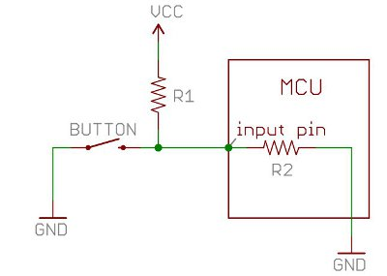
A more deeper look

Slide 42
A more deeper look
When the button is pressed, the input pin is pulled low. The value of resistor R1 controls how much current we want to flow from VCC, through the button, and then to ground.

Slide 43
A more deeper look
When the button is not pressed, the input pin is pulled high. The value of the pull-up resistor controls the voltage on the input pin.

Slide 44
A more deeper look
Because of the two opposing factors the resistor value cannot be too high not too less
Depending on the context you choose an appropriate value

Slide 45
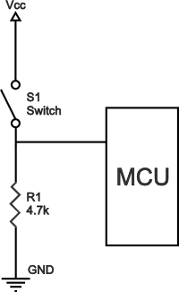
Pull Down Resistor

Slide 46
ATmega 32 has internal pull up resistors!!
If PORTxn is written logic one when the pin is configured as an input pin, the pull-up resistor is
activated.
Here, x = A,B,C, or D
n is bit number, e.g., 0,1,2,..., or 7

Slide 47
General Discussion
If some pins are unused, it is recommended to ensure that these pins have a defined level.
The simplest method to ensure a defined level of an unused pin, is to enable the internal pullup.

Slide 48
Resources
DataSheet
Pull Up and Pull Down Resistors
http://www.resistorguide.com/pull-up-resistor_pull-down-resistor/
More on Pull Up and Pull Down resistors
https://learn.sparkfun.com/tutorials/pull-up-resistors

Slide 49
☺

